Slide 1
Software Architecture

Slide 2
We cover
What is Software Architecture (definition)
How and when are architectural decision made?
Briefly consider different architectural styles
How do we document architecture (views & UML)

Slide 3
Hierarchical Organisation of Software
Software has structure (not just lines of code)
Software can be organised hierarchically
Data and memory
Algorithms
Objects
Modules
Component
System
System of systems
How do we decompose software systems into parts?
Notes:
And how do we do it systematically?

Slide 4
System Decomposition… but why?
The what:
System decomposition is the process of breaking down a complex system into smaller, more manageable components.
three key principles:
Modularity – divide-and-conquer
Little problems are easier to solve than big ones
Abstraction – Don’t re-invent the wheel
Focus on creative parts; if something already exists, reuse it
Encapsulation – Separation of concerns
Support flexibility and future evolution by decoupling unrelated parts, so each can evolve separately

Slide 5

Software Architecture ?
Notes:
We’ve spoken about decomposing system. Where does architecture fit in?

Slide 6

Software Architecture
Software architecture refers to the set of high-level decisions that determine the structure of the software solution
Parts of the system
Relationships between parts
These decisions are often made early in the design process and affect large parts of the system
Can be difficult to modify later
Aim to use well-known solutions that are proven to work for similar problems
Software architecture is not a phase of development, rather it refers to the structure of the software system at any point in development

Slide 7
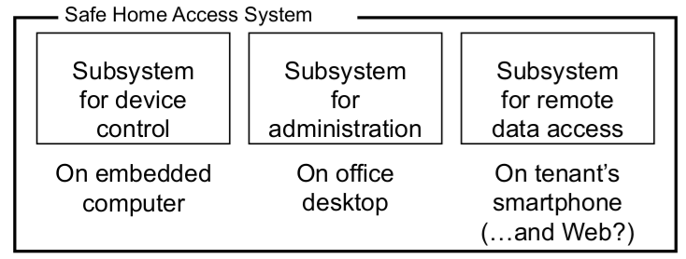
Architectural Decisions
Example decisions:
How do we decompose the system?
How do we map software to hardware?
What development platforms, deployment operating systems, etc. will be used?
How will these subsystems interact?
“Architectural style”
Example: Home Security

Slide 8
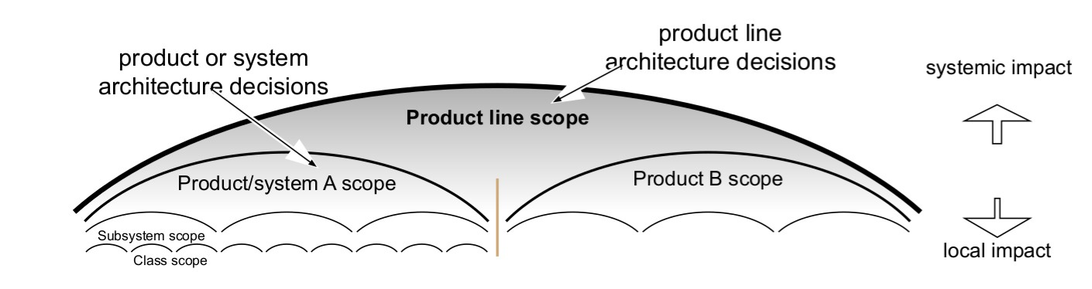
Architectural Decisions: Scope
Given the current level of system scope, a decision is “architectural” if it can be made only by considering the present scope
i.e. could not be made from a more narrowly-scoped, local perspective
Architectural decisions should focus on high impact, high priority areas that are in strong alignment with the business strategy

Slide 9
Key Decisions
System decomposition
How do we break the system up into parts?
What functionality/behavior to include?
Do we have all the necessary parts?
How do the parts interact?
Cross-cutting concerns
Broad-scoped qualities or properties of the system
i.e. non-functional requirements
Usually a trade-off between qualities
Conceptual integrity
Does the system make sense?

Slide 10
Architecture vs Design
Architecture focuses on non-functional requirements and on the decomposition of a system
Design focuses on implementing functional requirements
Note: the border is not always clear

Slide 11
Compromise
Architectural decisions always involve compromise
Additional considerations:
Business priorities
Available resources
Target customers
Competitors’ moves
Technology trends
Backward compatibility
Security & Sovereignty needs
Reliability and Scalability needs
Notes:
The “best” design for a component considered in isolation may not be chosen when components considered together or within a broader context
e.g. car components may be “best” for racing cars or “best” for luxury cars, but will not be best together

Slide 12
Architectural Styles
An architectural style (or architectural pattern) is a general, reusable solution to a commonly occurring problem in software architecture within a given context
Different from, but related to, design patterns

Slide 13
Architectural Styles
Some well-known architectural styles include:
Monolithic
Client-Server
Peer-to-Peer
Multi-Tier
Pipe and Filter
Database-Centric
Event-Driven
Microservices
Microkernel
Representational State Transfer (REST)
Service-Oriented
Space-Based
Not an exhaustive list!

Slide 14
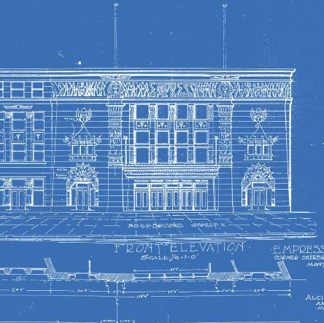
Describing Architecture
How do we describe the components of a system and how they interact?
Each component must be identified, and its interface described. Interfaces must be:
Fully documented
Semantics, not just syntax
Understandable
Unambiguous
Precise
Adding semantics:
Informal description
Design models (UML diagrams)
Pre/Post conditions
Notes:
We know what architecture is. But how do we describe it?

Slide 15
Architectural Views
Views are different kinds of “blueprints” created for the system-to-be
e.g. Blueprints for buildings: construction, plumbing, electric wiring, heating, air conditioning, etc.
Different stakeholders have different information needs
Each view has a purpose, and only shows the information related to that purpose
Unnecessary information would clutter the view, making it unintelligible

Slide 16
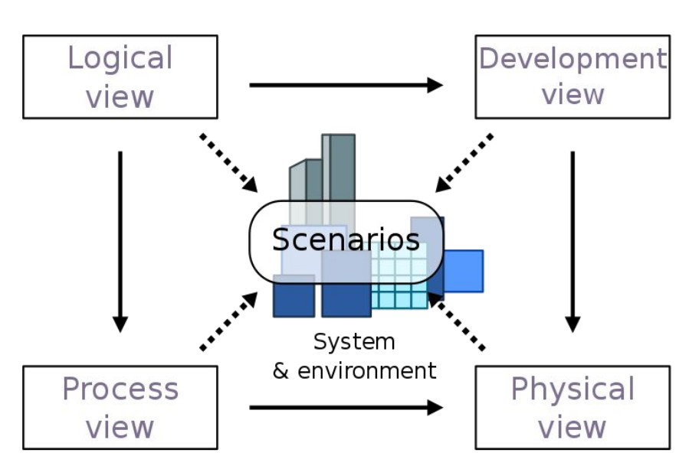
4+1 Architectural View Model
The 4+1 Architectural View Model, developed by Philippe Kruchten, is a conceptual framework used to describe the architecture of software-intensive systems. It provides a structured approach to capturing and documenting different aspects of system architecture by organizing them into multiple views. The "+1" refers to the use of multiple views to address various stakeholders' concerns.

Slide 17
4+1 Architectural View Model
4 + 1 Architectural View Model
Logical View
State Diagram
Class Diagram
Development view
Component Diagram
Process View
Activity Diagram
Sequence Diagram
Physical view
Deployment Diagram
Scenario view
Use Case Diagram

Slide 18

Let’s dive deeper

Slide 19
Logical View
The logical view is concerned with the functionality provided to users
Focuses on the decomposition of the system into a set of key abstractions, namely objects and classes
Represented in UML using class diagrams and state diagrams

Slide 20
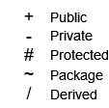
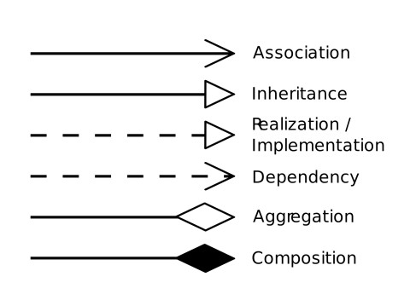
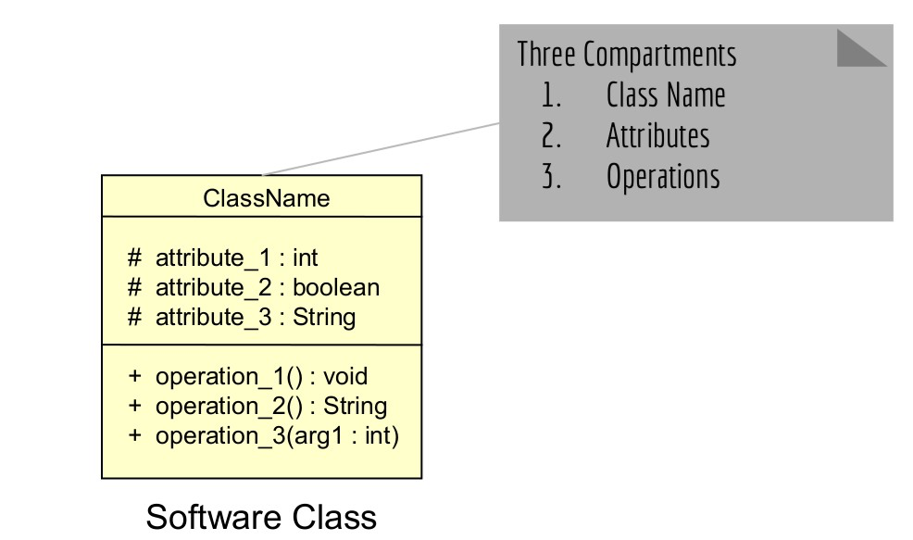
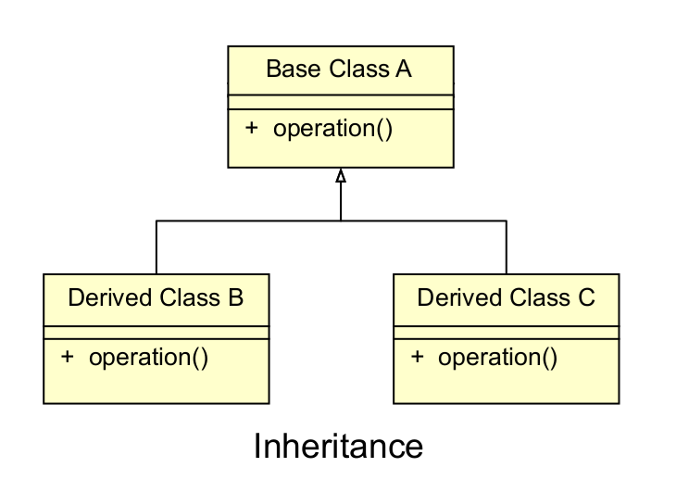
Logical View – Class Diagrams
See lecture on The Object Model .
Static view of the classes/objects in a system
Can be generated from code
See tools like Umbrello, Smartdraw, etc.

Slide 21
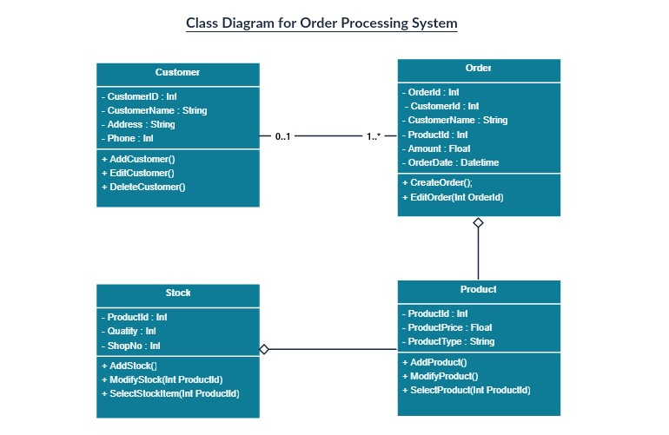
Logical View – Class Diagrams

Slide 22
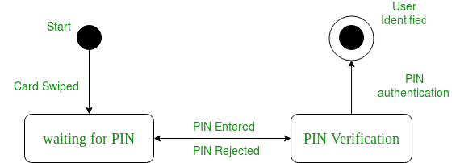
Logical View – State Diagrams
State diagrams (also known as statechart diagrams) give a dynamic view of objects
Define states for each object and how objects transition between states
Models an object’s lifetime from creation to termination

Slide 23
Logical View – State Diagrams
How to draw:
Circle – initial state
Rectangle - state
Arrow – transition between state, labelled with text
Diamond – choice states
Circle with outer circle – termination state

Slide 24
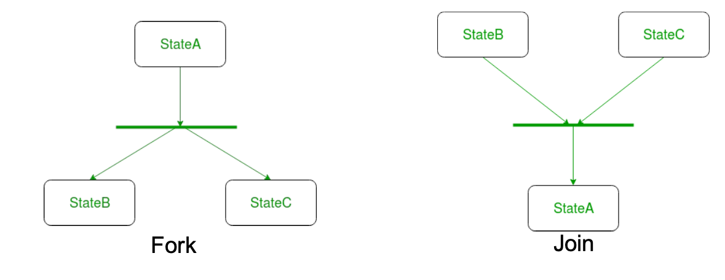
Logical View – State Diagrams
We sometimes represent forks and joins with a bar
Forks represent concurrent states (parallelism)

Slide 25
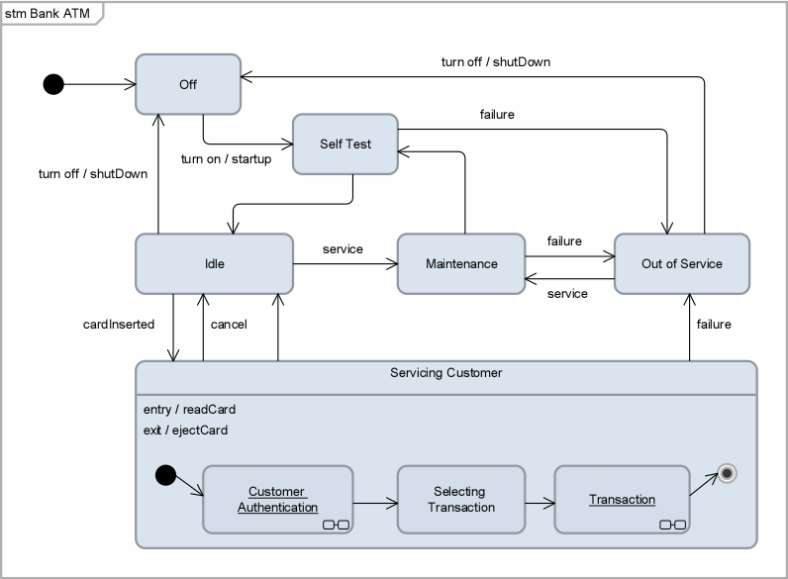
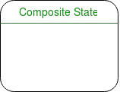
Logical View – State Diagrams
We can represent subprocesses using composite states

Slide 26
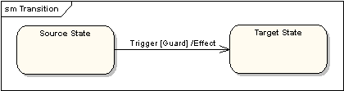
Logical View – State Diagrams
We can label triggers, guards and effects
Trigger – cause of transition
Guard – condition
Effect – action as a result of transition

Slide 27
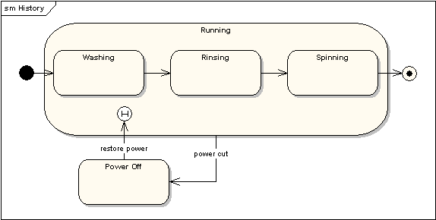
Logical View – State Diagrams
History states are used to remember the last state in case of interruption

Slide 28
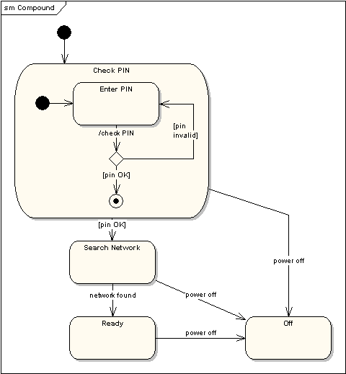
Logical View – State Diagrams
We can show compounded state diagrams with subsystems

Slide 29
4+1 Architectural View Model
4 + 1 Architectural View Model
Logical View
State Diagram
Class Diagram
Development view
Component Diagram
Process View
Activity Diagram
Sequence Diagram
Physical view
Deployment Diagram
Scenario view
Use Case Diagram

Slide 30
Development View
The development view is concerned with software administration from the point of view of the programmer
Focuses on components: modules of classes that represent independent systems or subsystems with the ability to interface with the rest of the system.
Represented in UML using component diagrams

Slide 31
Development View: Component Diagrams
Component diagrams illustrate the pieces of software, embedded controllers, etc., that will make up a system. A component diagram has a higher level of abstraction than a Class Diagram - usually a component is implemented by one or more classes (or objects) at runtime. They are building blocks so a component can eventually encompass a large portion of a system.

Slide 32
Development View: Component Diagrams
Component diagrams show how different components in a system interact.

Slide 33

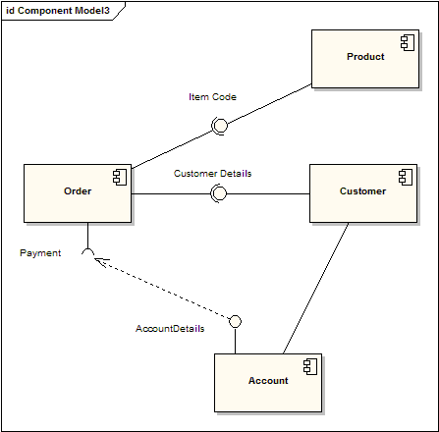
Development View: Component Diagrams
The diagram demonstrates some components and their inter-relationships. Assembly connectors "link" the provided interfaces supplied by "Product" and "Customer" to the required interfaces specified by "Order". A dependency relationship maps a customer's associated account details to the required interface; "Payment", indicated by "Order".

Slide 34
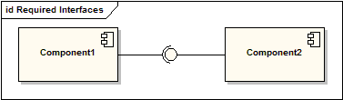
Development View: Component Diagrams
Components are represented as a rectangular classifier with the keyword «component»; optionally the component may be displayed as a rectangle with a component icon in the right-hand upper corner.

Slide 35
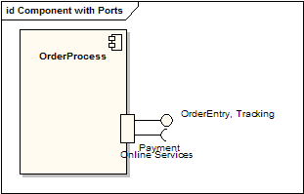
Development View: Component Diagrams
Using Ports with component diagrams allows for a service or behavior to be specified to its environment as well as a service or behavior that a component requires. Ports may specify inputs and outputs as they can operate bi-directionally. The diagram details a component with a port for online services along with two provided interfaces order entry and tracking as well as a required interface payment.

Slide 36
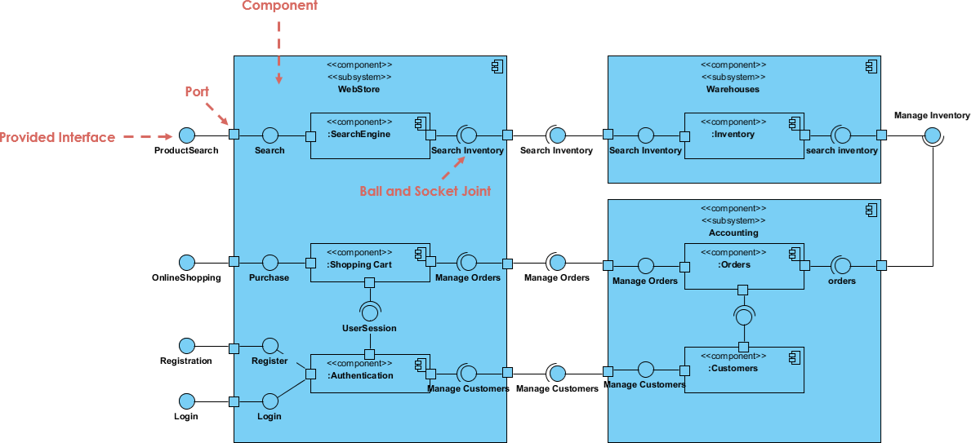
Development View: Component Diagrams
Rectangles = components
Symbol in top right corner
Type and name at the top Squares = ports
Squares = ports
Sometimes used to mark interfaces
Ball = provided interface
Socket = required interface
Notes:
Provided: component offers or exposes to its environment.
Required: component depends on or requires from its environment

Slide 37
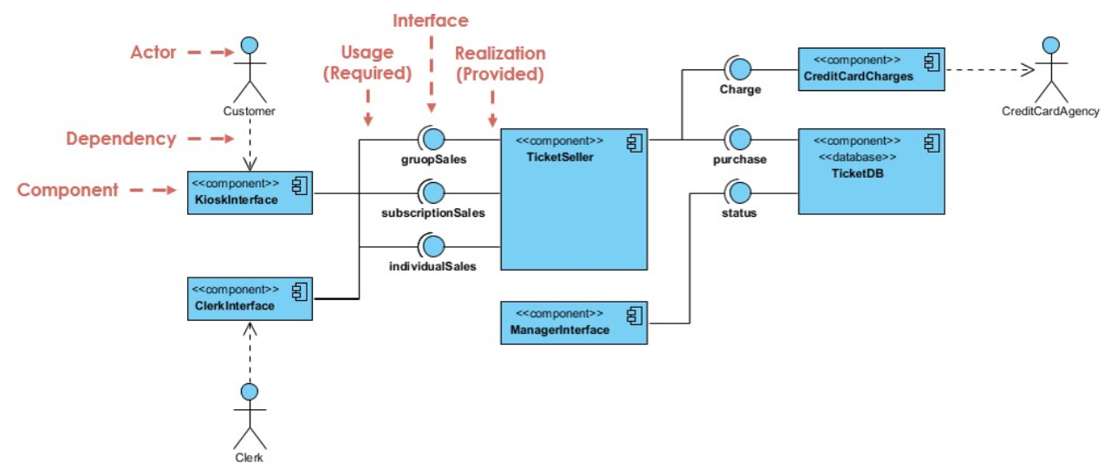
Development View: Component Diagrams

Slide 38
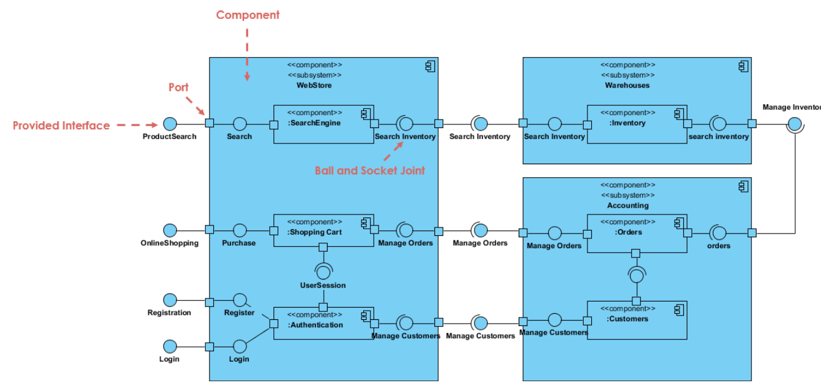
Development View: Component Diagrams

Slide 39
4+1 Architectural View Model
4 + 1 Architectural View Model
Logical View
State Diagram
Class Diagram
Development view
Component Diagram
Process View
Activity Diagram
Sequence Diagram
Physical view
Deployment Diagram
Scenario view
Use Case Diagram

Slide 40
Process View
The process view is concerned with the dynamic aspects of the system, explaining the system processes and how they communicate
Focuses on the runtime behaviour of the system
Represented in UML using activity diagrams and sequence diagrams

Slide 41
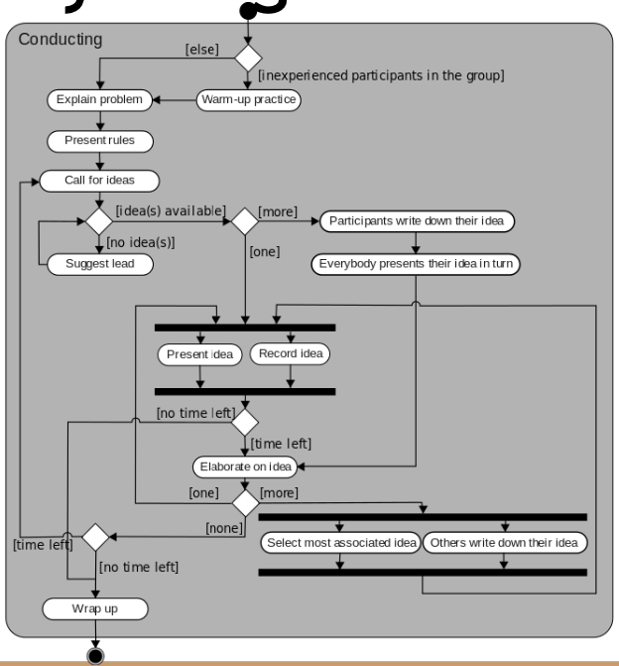
Process View – Activity Diagrams
Activity diagrams show the workflow of a system
Blocks represent actions
Diamonds represent decisions
Bars represent forks/joins of concurrent activities
Circle represents start
Outlined circle represents end of process
Similar to state diagrams, but show system activities rather than object states

Slide 42
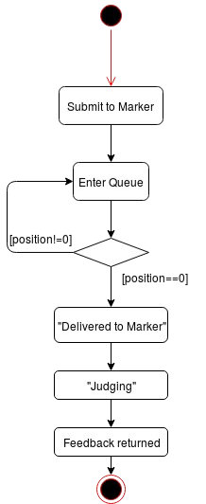
Process View – Activity Diagrams

Slide 43
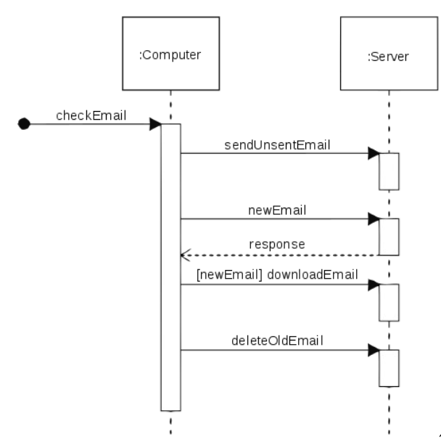
Process View – Sequence Diagrams
Sequence diagrams show how components/objects in a system interact over time
Typically associated with the use case realisation of the logical view

Slide 44
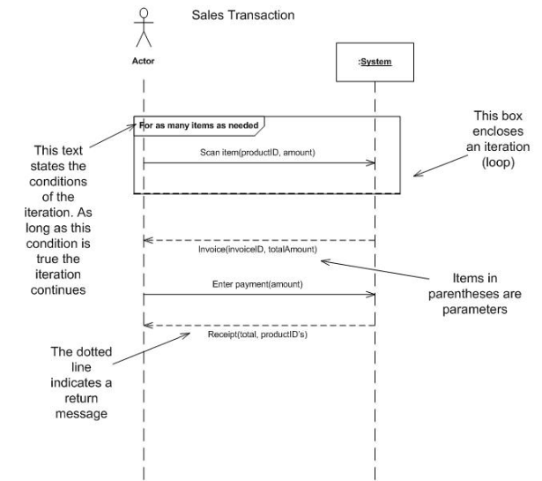
Process View – Sequence Diagrams
Box on top represents an object/component
Stick figure on top represents an external actor
Dotted vertical line represents lifeline of system
Blocks along lifeline represent processes
Solid arrows represent communications (method calls)
Dotted arrows represent returns
Large box represents loops
Loop conditions in top left corner
Text above/below lines indicates methods and parameters

Slide 45
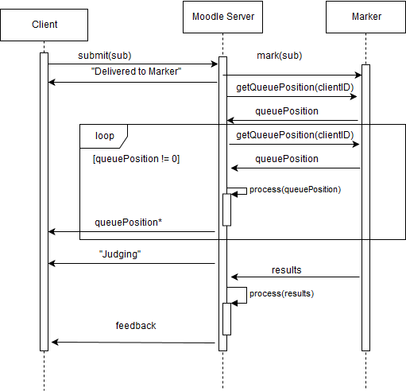
Process View – Sequence Diagrams

Slide 46
4+1 Architectural View Model
4 + 1 Architectural View Model
Logical View
State Diagram
Class Diagram
Development view
Component Diagram
Process View
Activity Diagram
Sequence Diagram
Physical view
Deployment Diagram
Scenario view
Use Case Diagram

Slide 47
Physical View
The physical view is concerned with the physical distribution of the system, as well as the physical connections between distributed parts
Depicts the system from a system engineer’s point of view
Represented in UML using deployment diagrams

Slide 48
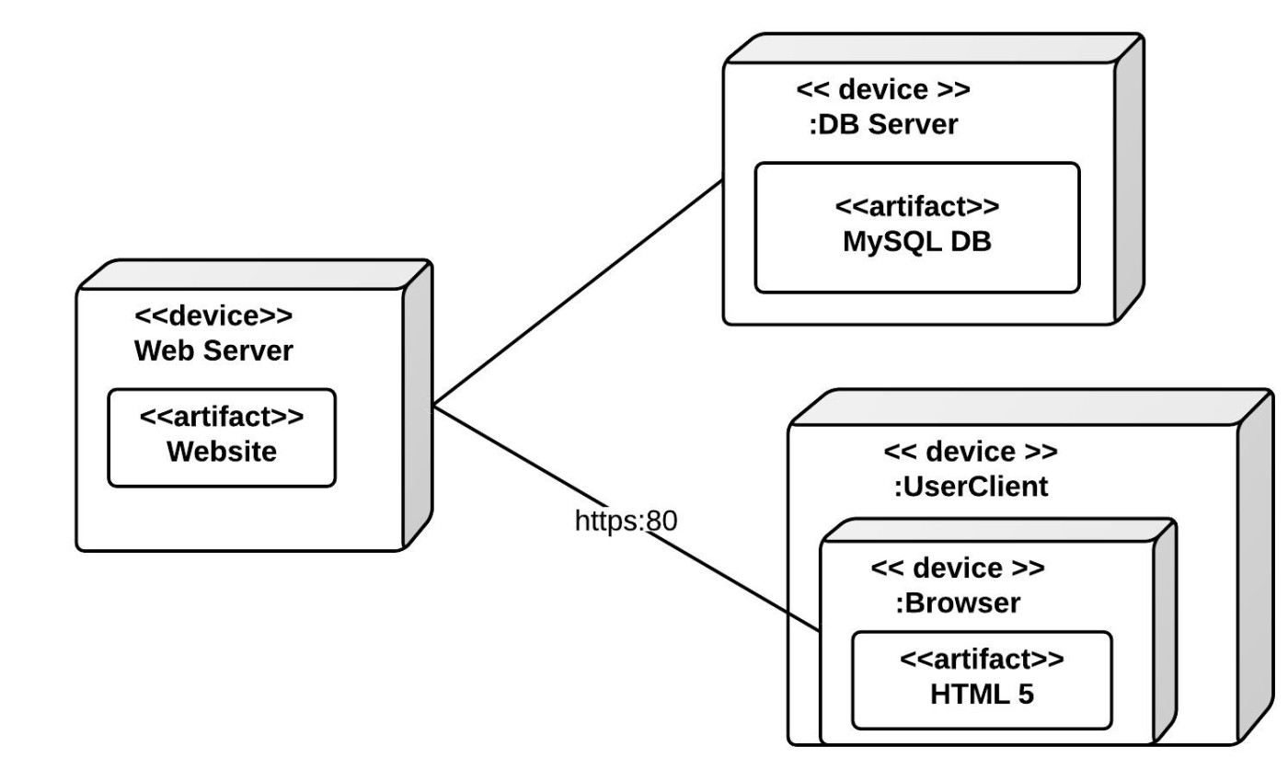
Physical View – Deployment Diagrams
Deployment diagrams model the physical deployment of artifacts (software components) on nodes (hardware components)
Artifacts modeled by rectangles
Sometimes a symbol in top right
Nodes modeled by 3D boxes
Communication modeled by lines

Slide 49
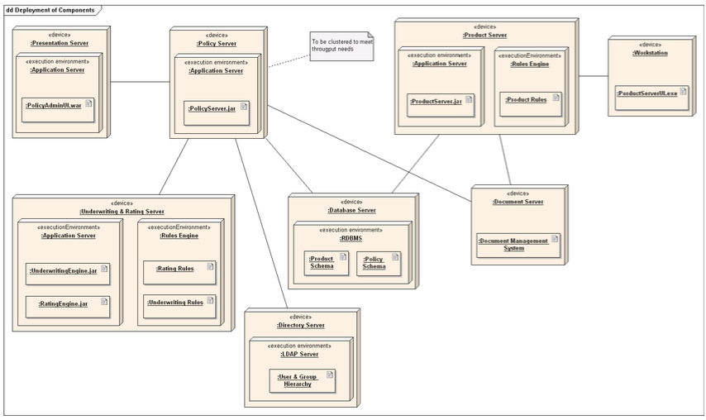
Physical View – Deployment Diagrams
Two types of nodes
Device nodes – physical devices that run software (computer, phone)
Execution Environment Node (EEN) – software resource that runs on a device and can execute other software (server, browser)
Distributed nodes can be conceptually represented as one

Slide 50
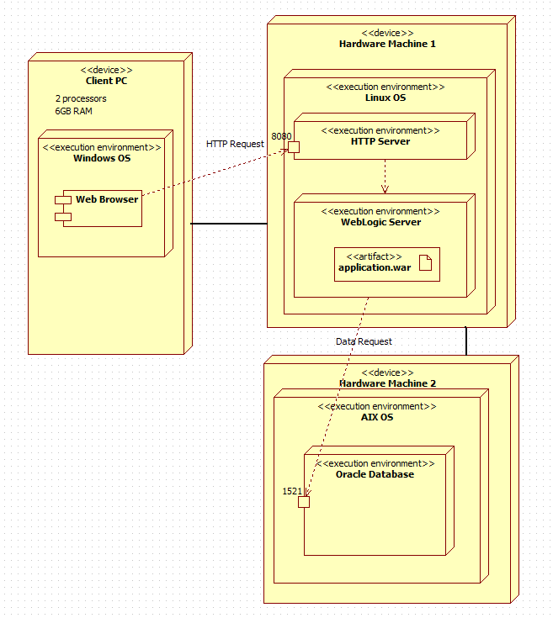
Physical View – Deployment Diagrams

Slide 51
4+1 Architectural View Model
4 + 1 Architectural View Model
Logical View
State Diagram
Class Diagram
Development view
Component Diagram
Process View
Activity Diagram
Sequence Diagram
Physical view
Deployment Diagram
Scenario view
Use Case Diagram

Slide 52
Scenarios
Scenarios, sometimes known as the use case view, describe the system’s architecture through use cases – the list defining interactions between a role and a system to achieve some goal
See Lecture 2 – Requirements
Represented in UML using use case diagrams

Slide 53
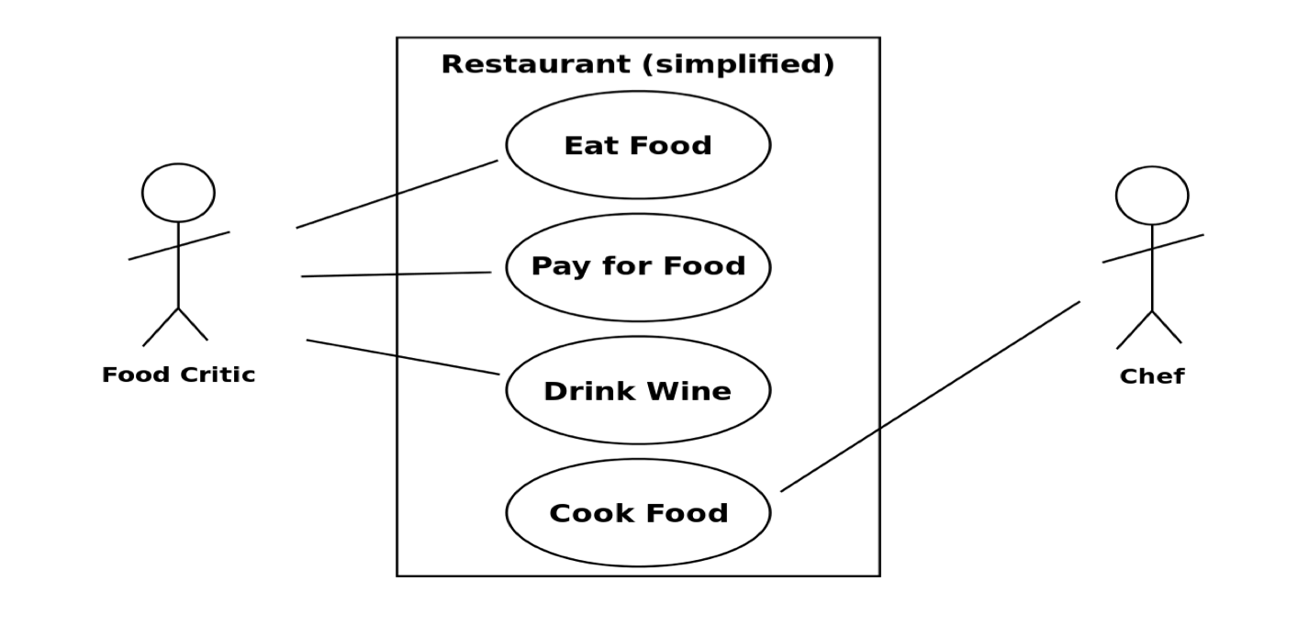
Scenarios – Use Case Diagrams
Ovals = use cases
Stick figures = actors
Boxes = system
boundaries Lines = associations

Slide 54
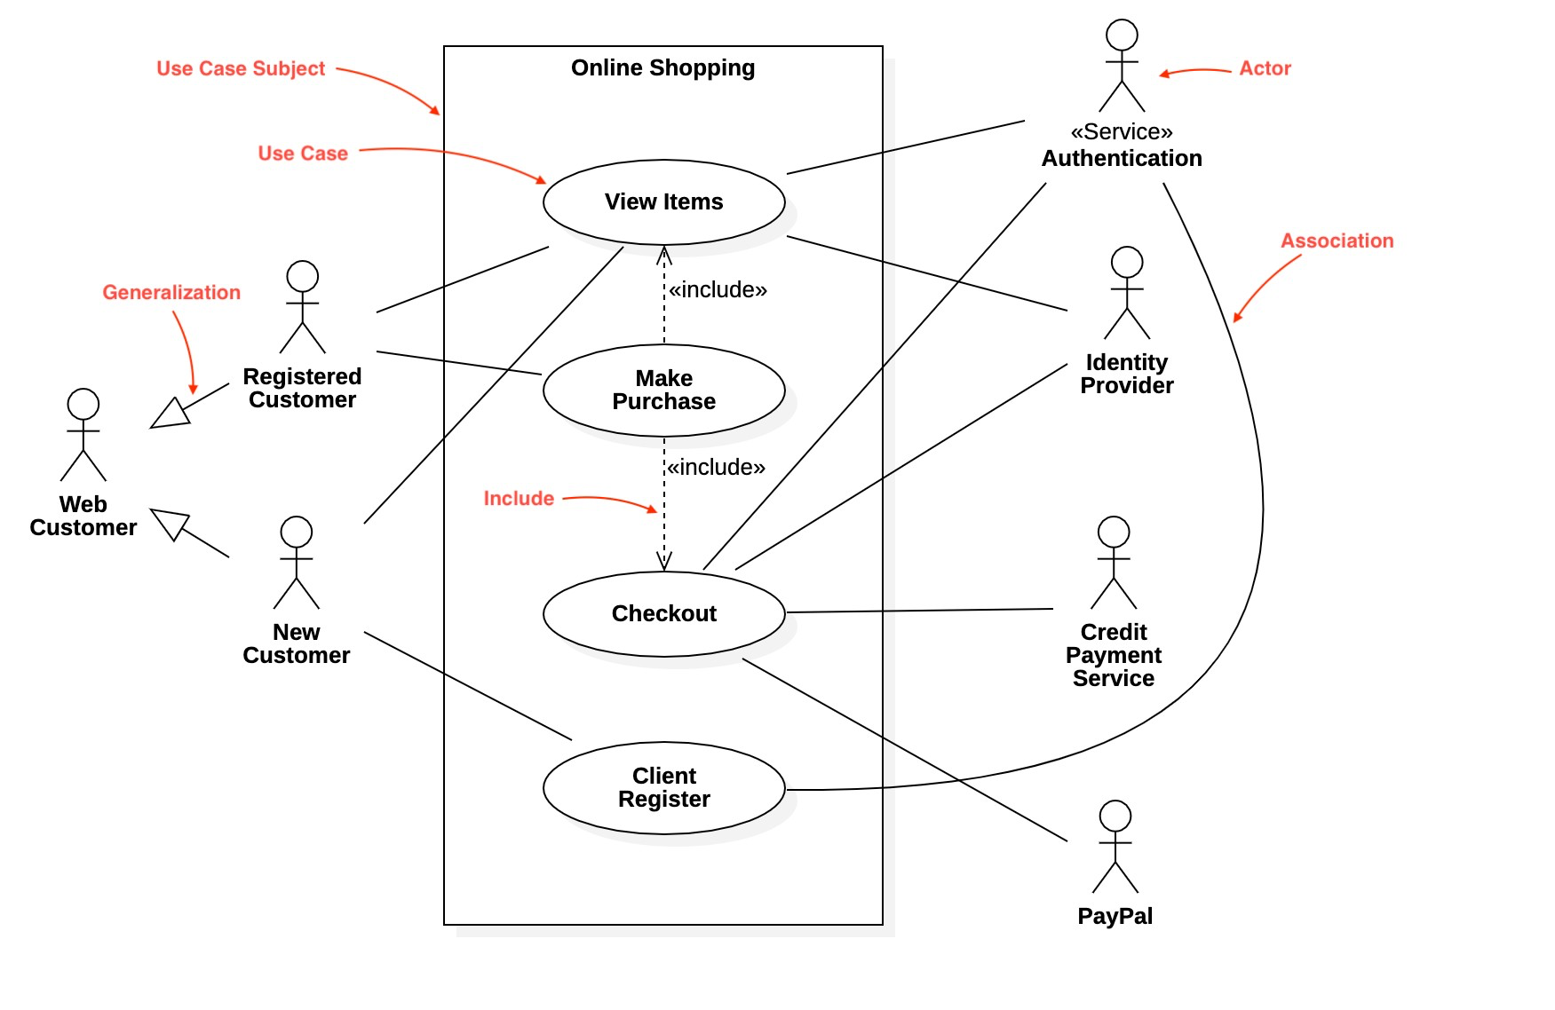
Scenarios – Use Case Diagrams

Slide 55
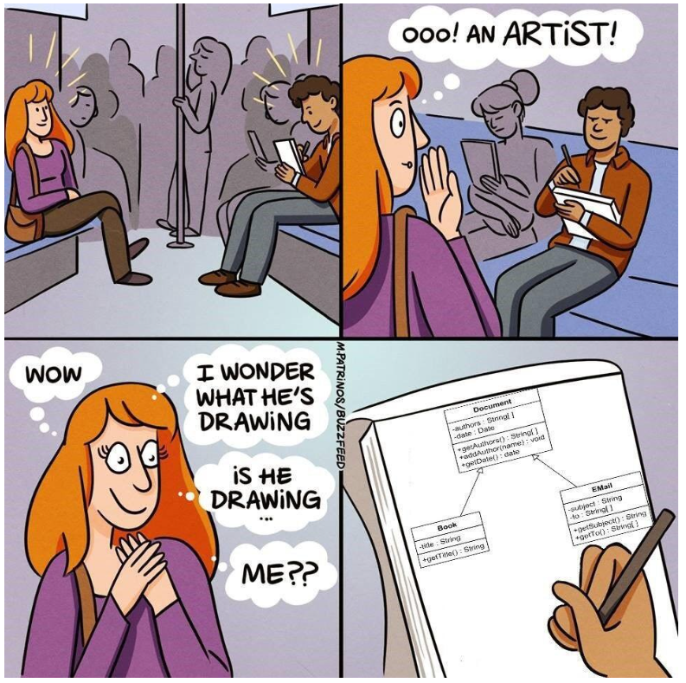
UML Tips
Use drawing tools
draw.io
Umbrello
Lucidchart
...and many many more
Notes:
Practice makes perfect

